Slide 1
PACKING UP PFAS
Transforming toxic PFAS-polluted clay soil into clean, usable bricks.

Slide 2
What are per- and polyfluoroalkyl substances (PFAS)?
Per- and polyfluoroalkyl substances (PFAS) are synthetic chemicals used since the 1950s for their resistance to water, grease, and heat.
F F F F F
| | | | |
C — C — C — C — C — COOH
| | | | |
F F F F F
A simplified diagram can illustrate PFOA (Perfluorooctanoic Acid), a well-studied PFAS, highlighting its indestructibility and nickname as "Forever Chemicals."

Slide 3
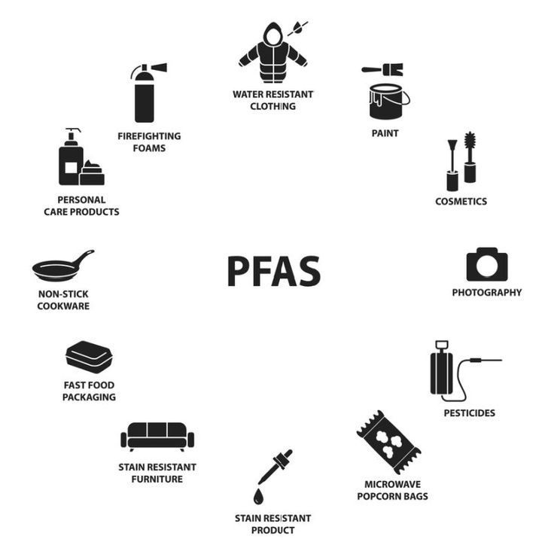
PFAS’ DIGEST
Per- and polyfluoroalkyl substances (PFAS) are man-made chemicals known for their strong carbon-fluorine bonds, making them resistant to heat, water, and oil. They are used in non-stick cookware, waterproof fabrics, firefighting foams, and industrial applications. However, PFAS persist in the environment, causing contamination of soil, water, and organisms.
Chemical Composition:
Carbon (C) backbone
Fluorine (F) atoms bonded to carbon
Functional group (e.g., COOH or SO3H) influencing chemical behavior

Slide 4
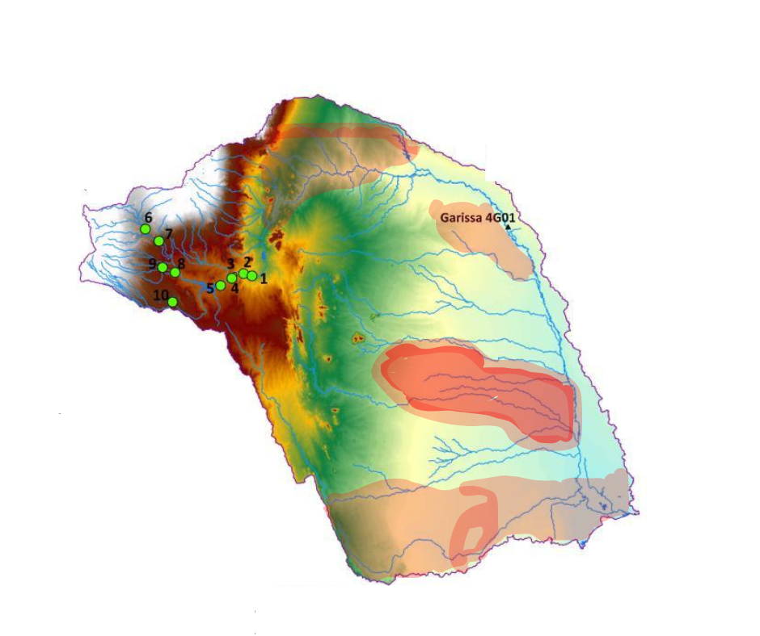
PROBLEM
PFAS Affected Areas
The Clay Building Ban: A Growing Crisis
Clay-rich soils in Africa are commonly used in construction but have faced bans, issued back in 2019, due to PFAS contamination, halting projects.
PFAS, toxic "forever chemicals," have infiltrated clay from industrial waste and other sources, rendering traditional materials unsafe. The lack of solutions has led to accumulating stockpiles of contaminated clay, exacerbating environmental and economic issues.

Slide 5
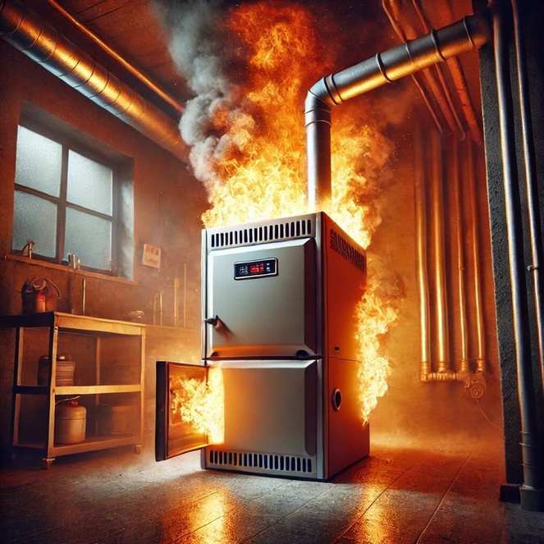
SOLUTION
Thermal Remediation:
Turning Contaminated Clay into Clean Bricks
A breakthrough solution lies in thermal remediation—heating PFAS-contaminated clay to 900°C, effectively breaking down toxic compounds. This process not only eliminates PFAS but also transforms the purified clay into durable ceramic material, ideal for producing bricks, tiles, and other construction materials. By repurposing contaminated soil into safe, high-quality building materials, we can lift clay bans, reduce hazardous waste, and promote sustainable construction across Africa.

Slide 6
COMPETITORS ANALYSIS
1
HIGH COST
2
LIMITED SCALE
3
INCOMPLETE REMOVAL
4
ENVIROMENTAL IMPACT
Existing PFAS removal techniques have challenges. Our solution provides complete removal. It's a cost-effective, scalable solution with lower environmental impact.

Slide 7
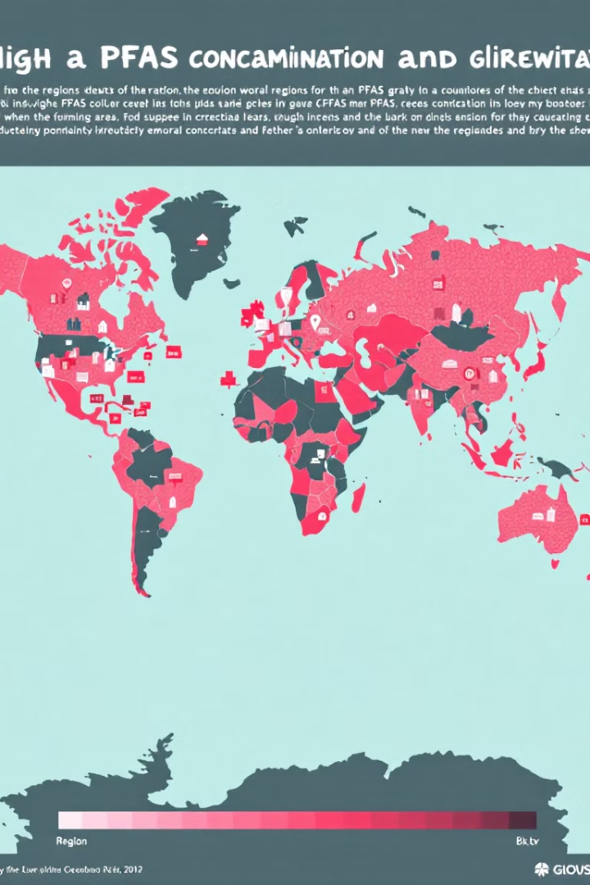



MARKET OPPORTUNITY
Construction
Bricks are produced in bulk and used as a local building material.
Remediation
Clay bricks offer cleaning methods.
Environmental
Solution to clean up PFAS.

Slide 8




VALUE CHAIN
1
2
EXTRACTION
THERMAL REMEDIATION
4
3
DIISTRIBUTION
3
MANUFACTURING
The value chain encompasses extraction of polluted clay soil. Followed by thermal remediation, manufacturing and distribution of clean bricks.

Slide 9

Business Model: How We Make Money
Our revenue model utilizes various streams to sustainably transform PFAS-contaminated clay into clean bricks.
1. Direct Sales (Wholesale & Retail)
2. B2B (Business-to-Business)
Selling PFAS-free bricks and ceramics to construction companies, developers, and consumers.
Providing bulk sales for government housing, real estate, and infrastructure projects.
Supplying clean bricks and construction materials to large-scale builders, contractors, and distributors.
Partnering with eco-friendly brands and sustainable construction companies to expand market reach.
3. Strategic Partnerships
4. Licensing & Patenting
Collaborating with governments, NGOs, and environmental agencies to replace contaminated clay with safe alternatives.
Working with waste management and industrial companies to clean PFAS-laden soil and repurpose it for construction.
Licensing the thermal remediation process to brick manufacturers and construction firms.
Securing patents to protect and monetize our proprietary technology, enabling licensing deals globally.

Slide 10
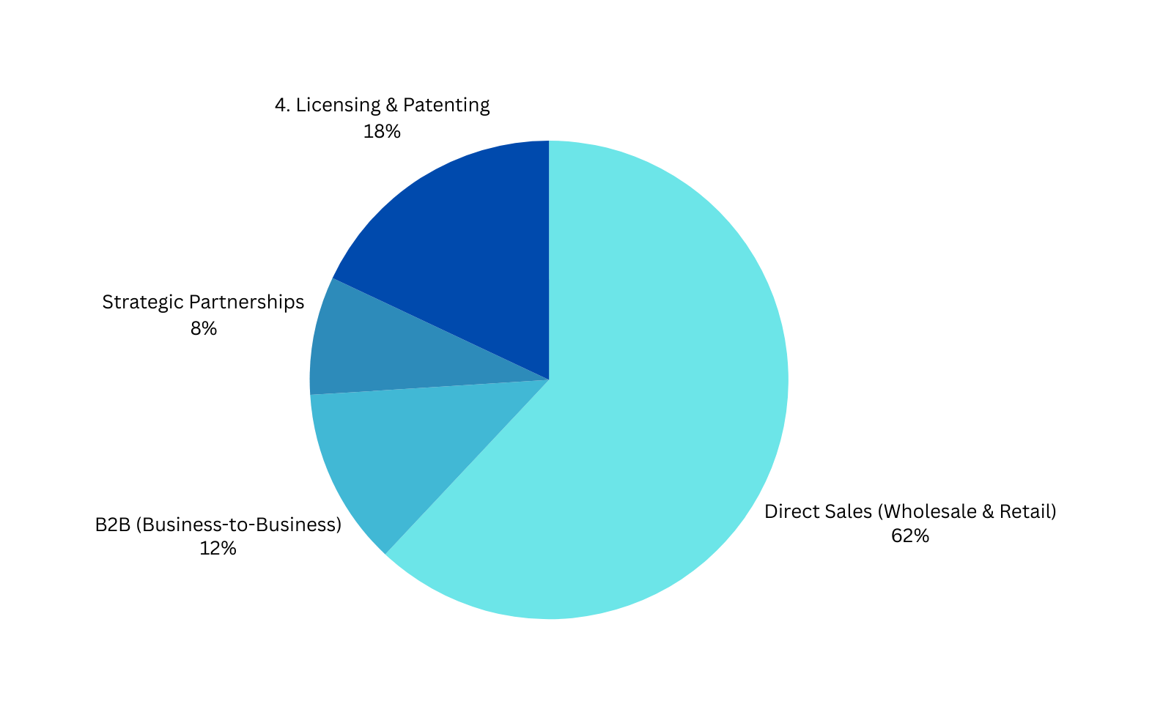
Business Model: Pie Chart

Slide 11
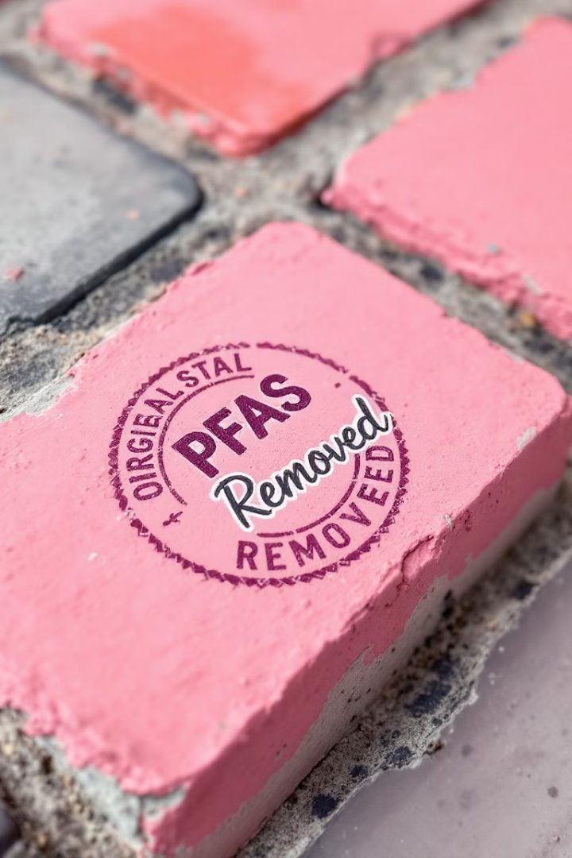



Traction: Proof of Concept
Clean Bricks
Origin Stamp
PFAS Removed
Three polluted clay soils were successfully transformed into clean bricks.
The stamp states the location of origin.
States the amount of PFAS removed.

Slide 12
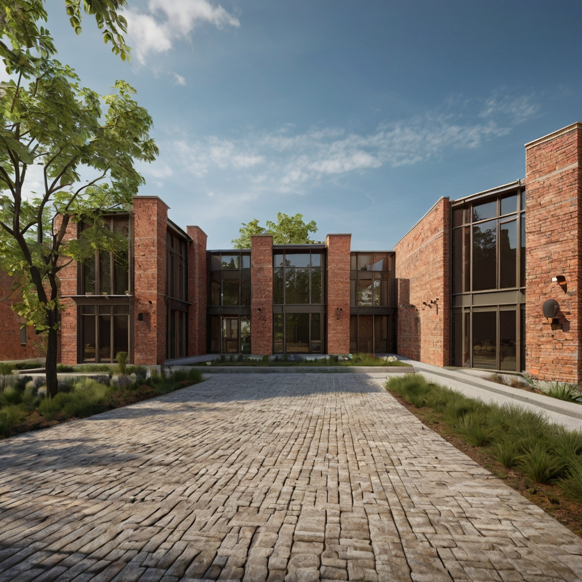
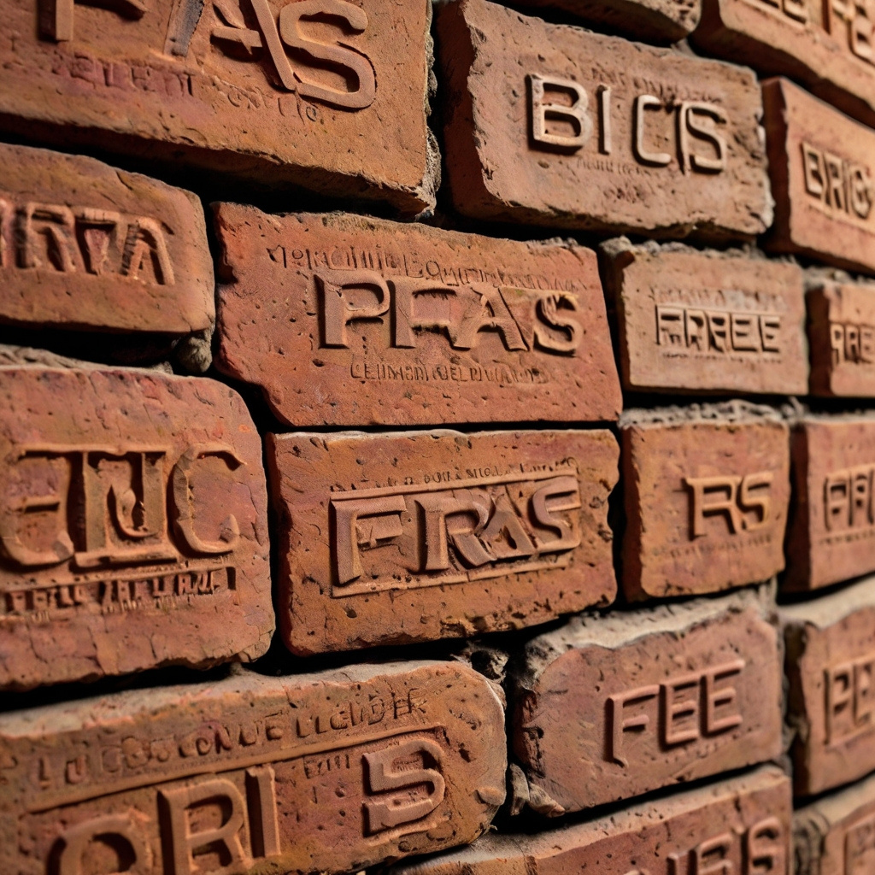
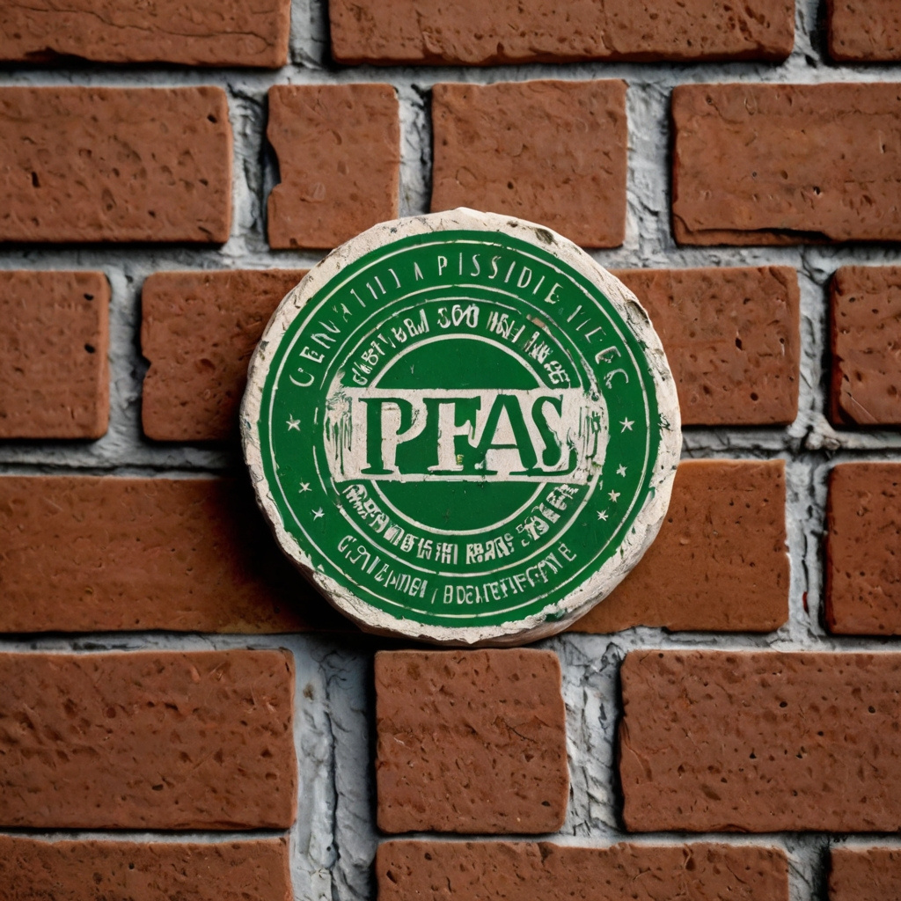
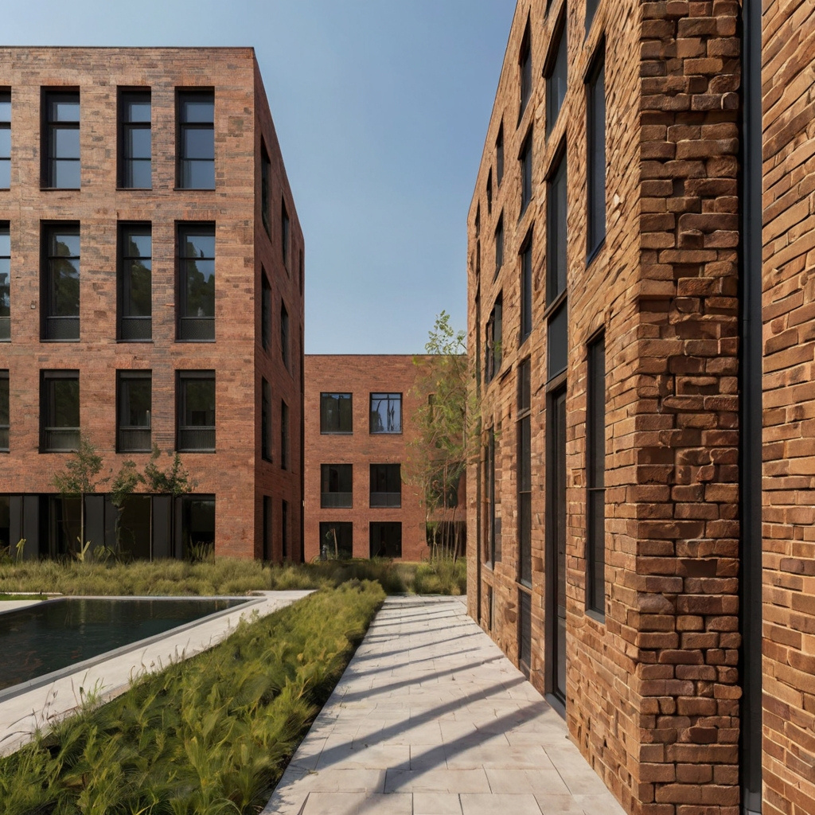
OUR PROJECTS

Slide 13
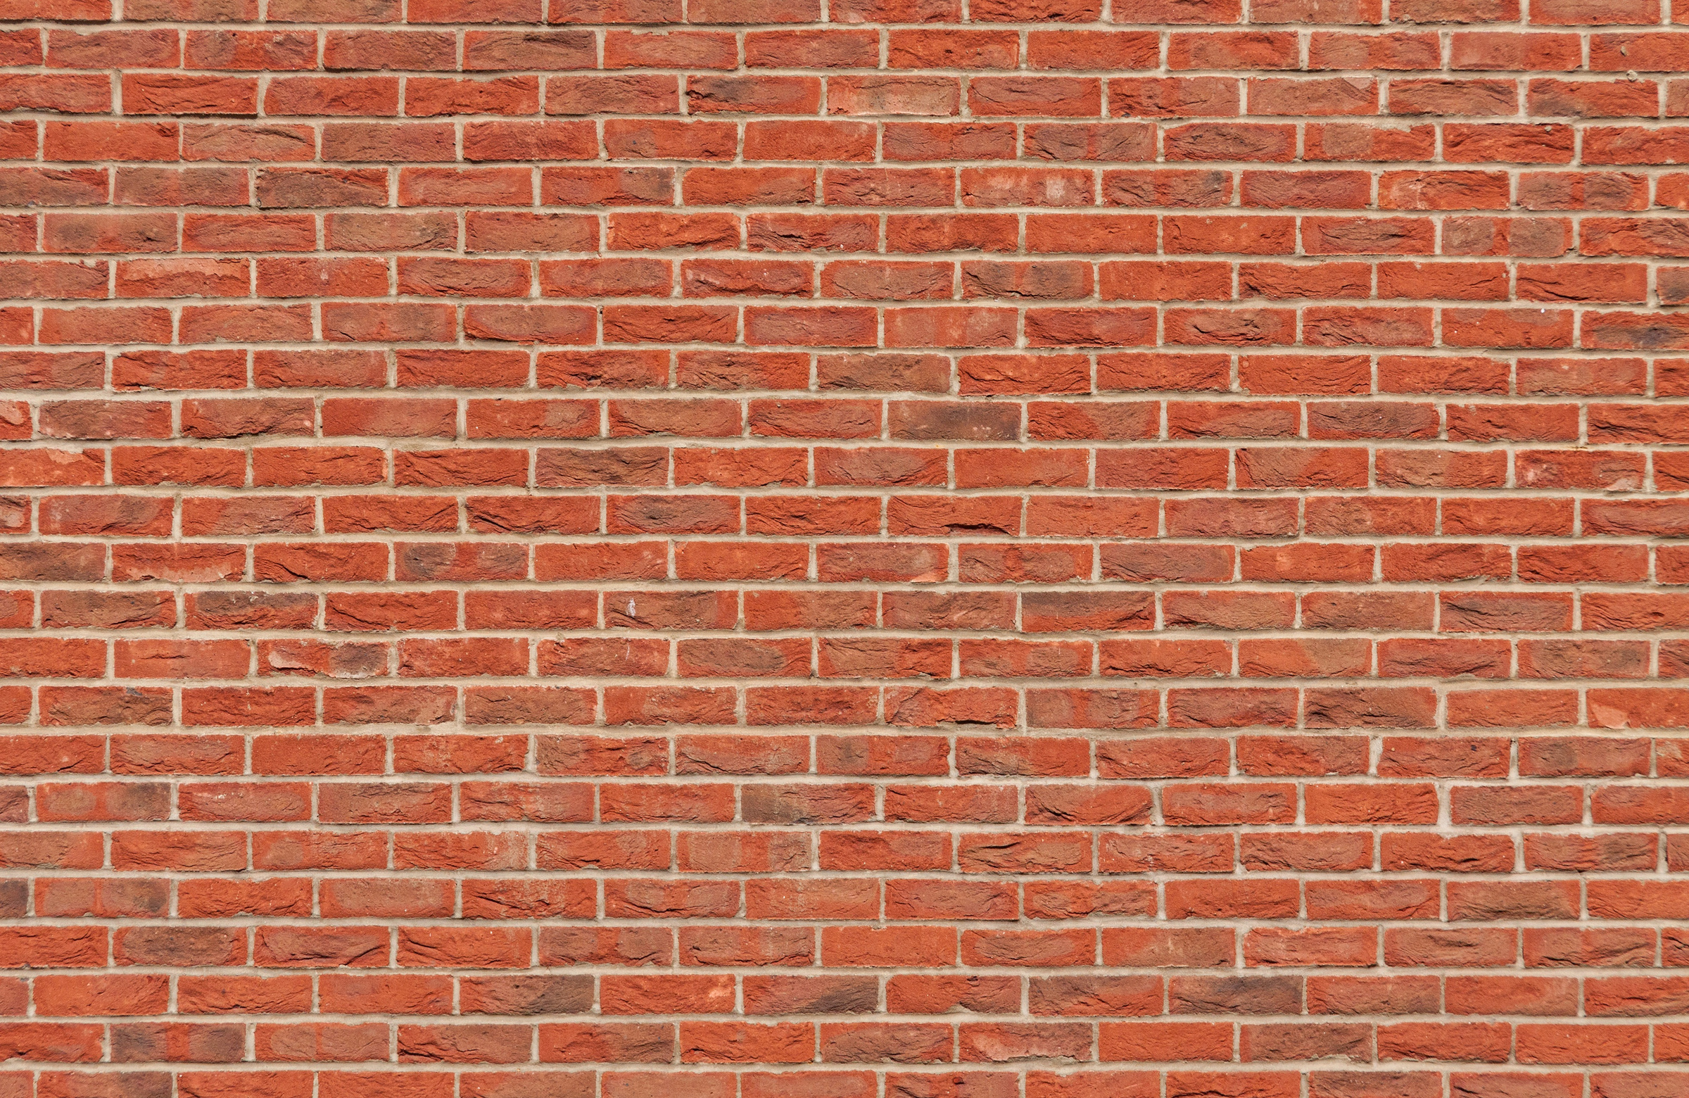


Our Aim:
100K
BRICKS
Annually
We're seeking funding to expand our solution. Transform toxic clay into valuable resources, paving the way for a cleaner future.

Slide 14
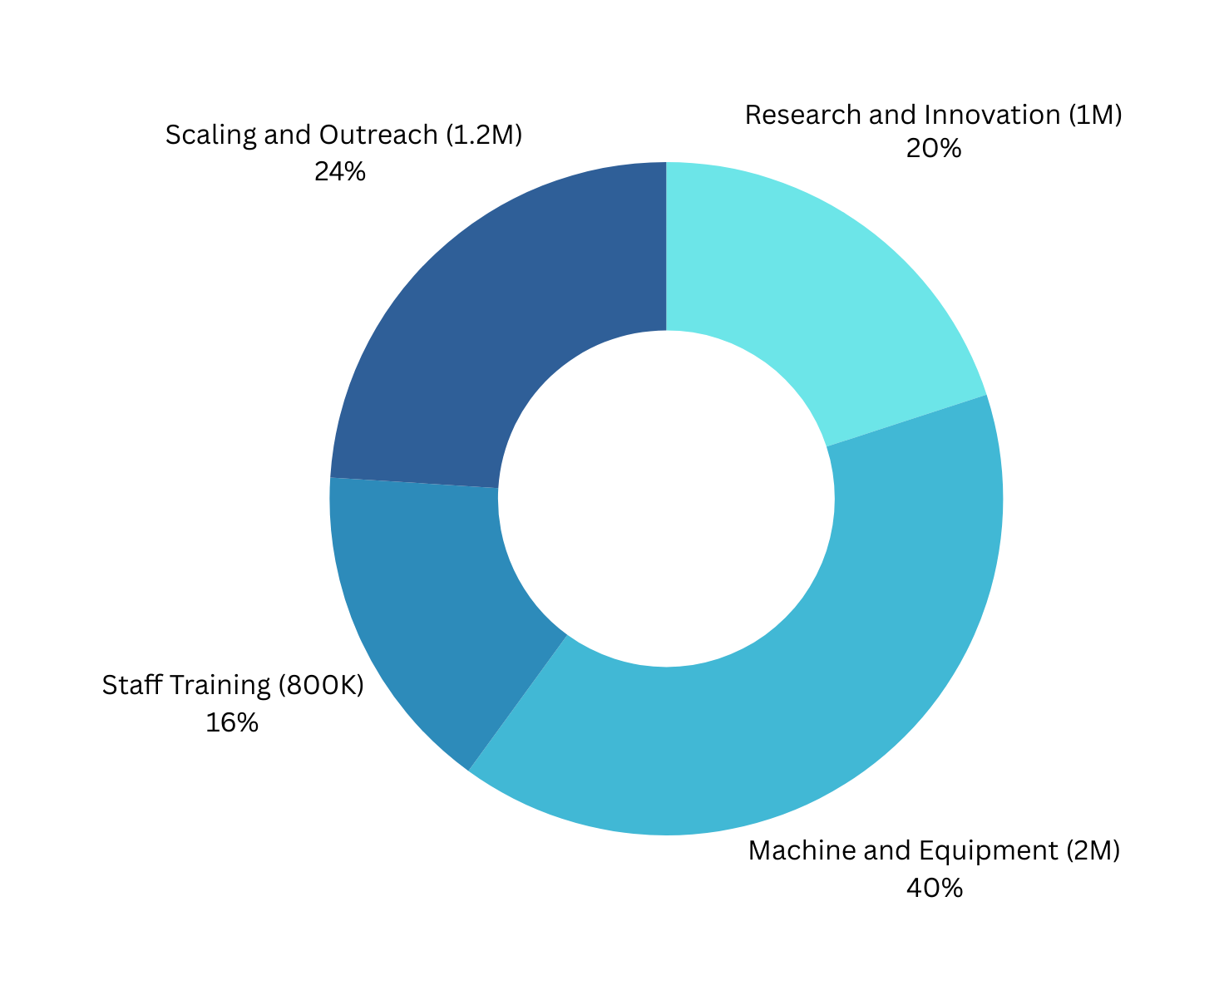
5M
OUR ASK
Funding
Requesting Ksh. 5M for scaling innovation, including equipment, research and development.

Slide 15
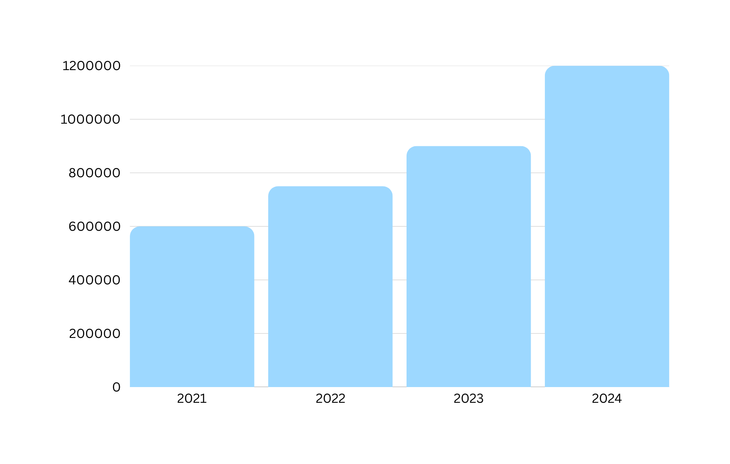
Revenue Growth Trend (2021-2024 Financial Years)

Slide 16

Meet Our Team
Ian Maina
Cherill Agessa
Joseph Muatha
Mary Munyao
Co-founder
Material Science Engineer
Business Development
Environmental specialist
Expert Geologist

Slide 17


Call to action
info@packinguppfas.com
0768899985

